Slide 2

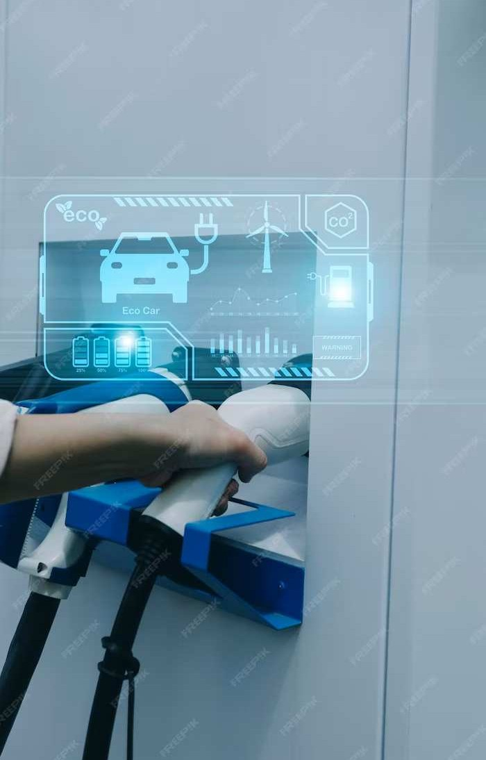
INTRODUCTION
Muhammad Adil
BCS213002
Omer Tanveer
BCS213004

Slide 3

Rainfall Prediction with Support Vector Machines

Slide 4

Introduction
Kepulauan Riau, Indonesia: 96% ocean, 2,400+ islands, prone to tropical storms.
Accurate rainfall forecasts for limited water resources, agriculture, and extreme weather events.
Unique geography makes accurate forecasting challenging.
Use of SVM improves accuracy.
Notes:
Apologies for the confusion. Here's a simpler introduction:
- **Streamlining Petrol Pump Operations:** The Petrol Pump Management System is a modern solution designed to simplify and automate the daily tasks of fuel station management.
- **From Manual to Automated:** This system replaces traditional manual processes, introducing automation to tasks such as sales recording, credit calculations, stock management, and data reading.
- **Efficiency at its Core:** With a focus on efficiency, the system aims to reduce errors, save time, and enhance overall productivity in the management of petrol pump stations.
- **Introduction to Automation:** Embracing advanced technology, the Petrol Pump Management System marks a shift towards a more automated and streamlined approach in the petroleum industry.

Slide 5

Problem Statement
Safety precautions for Natural disasters.
Reliance on rain for freshwater supply.
Extreme climate change.
Less accuracy in rainfall prediction due to geographical nature of archipelago.

Slide 6
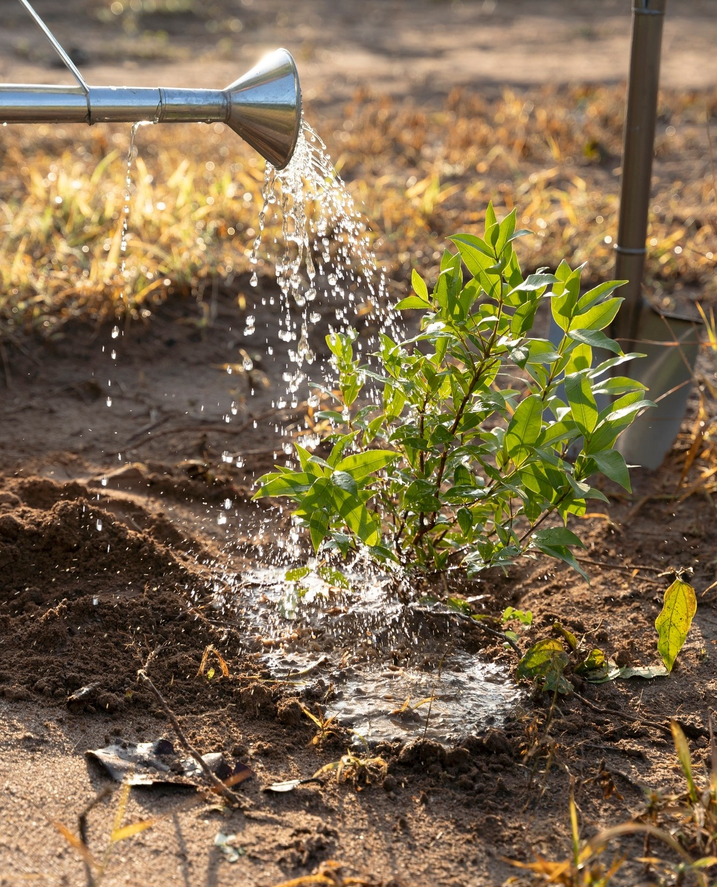
Objective
Develop and evaluate a specialized Support Vector Machine (SVM) model tailored for island conditions.
Prediction should be rain or no rain, means Binary classification.

Slide 7
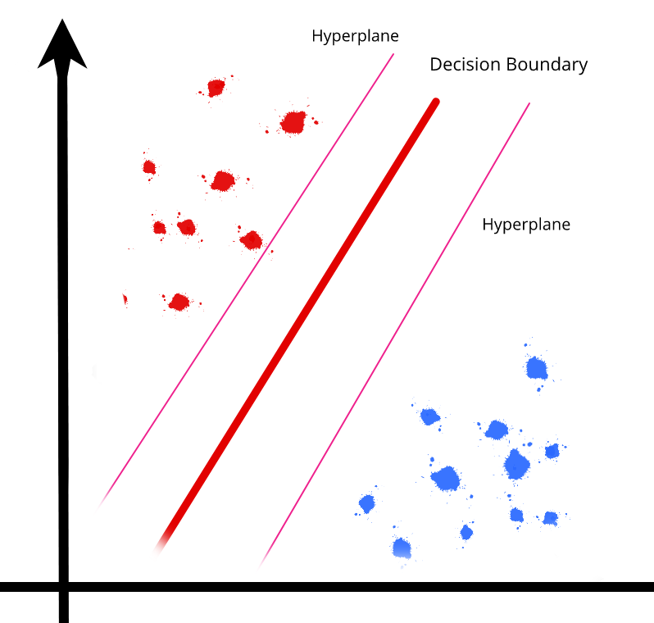
Methodology
We are using (SVM) Support Vector Machine in our model.
For Binary Classification as, rain or no rain.

Slide 8

Preparation
Utilized tools such as Google collab, a cloud based platform.
Panda, a data analysis library for structured data analysis.
Matplotlib was utilized for data visualization through graphs and plots.

Slide 9

Data Collection
Collected data from meteorological and geophysical stations in different areas.
Attributes included crucial factors in weather prediction.
Data divided into 80% training, 20% testing.

Slide 10

Data Preprocessing
Data preprocessing helps to clean the data from errors, missing values, and outliers.
It improves the quality of the data, which in turn can lead to better models.
Data preprocessing makes it possible to transform data into a form that is more suitable for machine learning algorithms.

Slide 11
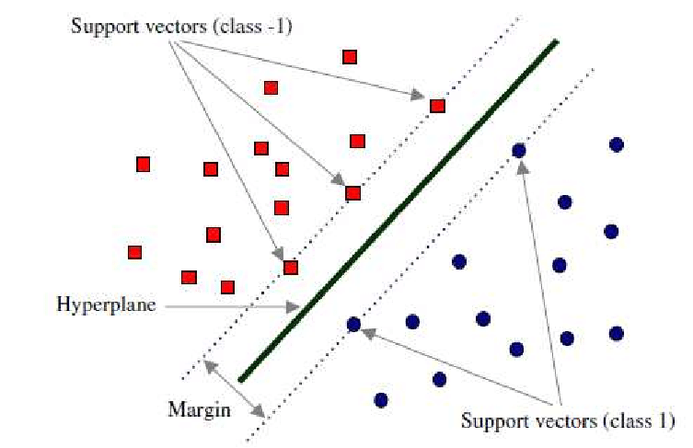
Training Data
SVM technique tries to find the optimal classifier to separate two different classes.
It tries to find the best dividing function (hyperplane) among an unconstrained number of functions to divide two types of objects
A good hyperplane is one that lies in the middle between two sets of objects from two classes.

Slide 12

Results
Data Loading and Cleaning
The dataset was successfully loaded from a CSV file
Rows containing missing values were removed to ensure the integrity of the dataset.

Slide 13

Data Splitting
The dataset was divided into training and testing sets, with an 80-20 split ratio.
80% training data.
20% testing data.

Slide 14

Support Vector Machine (SVM) Model Training
Linear Kernel function is used because data is linearly seperable.
Training SVM classifier on prepared training data.

Slide 15

Model Prediction
The trained SVM model demonstrated its predictive capabilities by forecasting rainfall or no rainfall on the test set.

Slide 16
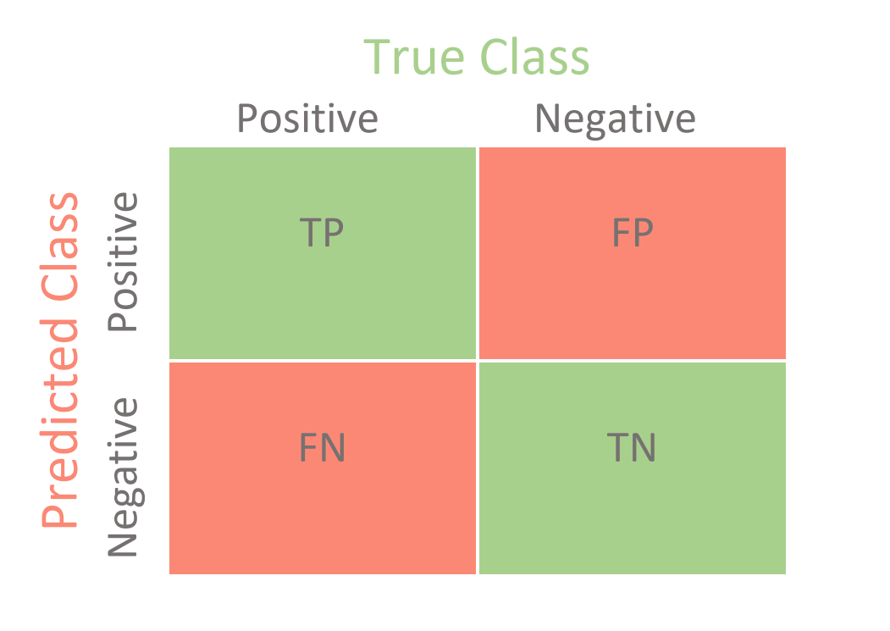
Confusion Matrix
Confusion Matrix is used to analyze the performance of the Support Vector Machine (SVM)
The confusion matrix is a table that summarizes the model's predictions, allowing for a detailed evaluation of classification results.

Slide 17


Slide 18

Conclusion
In conclusion, the developed SVM model effectively predicted rainfall based on collected data.
The model demonstrated reliable performance, Indicates its ability to distinguish between positive and negative rainfall events.

Slide 19



